Slide 1

Loan Prediction
Analysis

Slide 2



Overview
Introduction
Model Overview
Hyperparameter Search
SMOTE + ENN
Cross Validation
Experimental Result
Conclusion

Slide 3



INTRODUCTION
Problem: Predicting loan approval or rejection for applicants.
Objective: To build a predictive model for loan approval decision.
Dataset: Collection of historical loan application data.
Target: Binary outcome - Approved (1) or Rejected (0).
Steps:
Data Pre-processing: Cleaning, handling missing values, encoding categorical features.
Exploratory Data Analysis: Creating relevant features for better prediction.
Model Selection: Choosing suitable ML algorithms (e.g., Logistic Regression, Decision Trees, Random Forests).
Hyperparameter Tuning: Using GridSearch to optimize model performance.
Model Training: Training the selected model on the preprocessed data.
Model Evaluation: Assessing model accuracy and performance metrics.
Prediction: Using the trained model to predict loan approval for new applicants.
Challenges: Dealing with imbalanced classes, handling missing data, and ensuring fairness in decision-making.
Benefits: Streamlining loan approval process, reducing manual effort, and improving accuracy.
Impact: Helps financial institutions make informed decisions and reduces risks associated with lending.

Slide 4

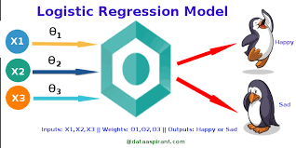
Logistic Regression
What is Logistic regression?
Regression analysis uses logistic regression to estimate a logistic model's parameters.
When the dependent variable is a categorical variable, logistic regression is utilised.
Types of LR:
Binary (two outcomes in the dependent variable),
Multinomial (three or more outcomes in the dependent variable)
Ordinary (three or more outcomes in the response variable)

Slide 5
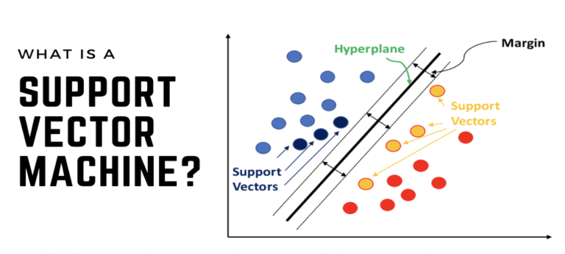
Support Vector machine
SVM is a powerful ML algorithm for classification, regression, and outlier detection tasks.
It finds the optimal hyperplane in N-dimensional space to separate data points into different classes.
The hyperplane is the line that has the maximum margin between the two classes.
The margin is the distance between the hyperplane and the nearest data points of each class.
The SVM algorithm tries to find the hyperplane with the maximum margin, which ensures that the model is as robust as possible to noise in the data.

Slide 6
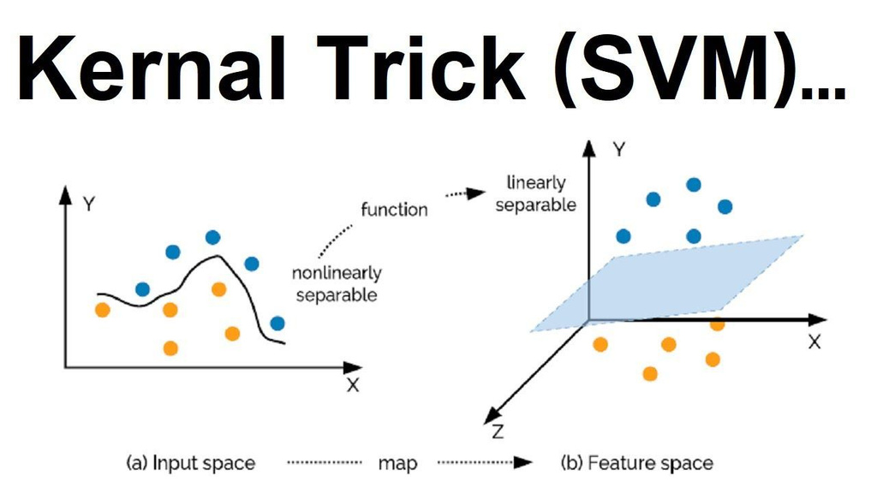
Support Vector machine
Powerful algorithm for diverse problems.
Effective in high-dimensional spaces, excels in generalization.
Robust to data noise.
Computationally expensive for large datasets.
Kernel trick for non-linear classification.
Suitable for binary and multi-class classification.
Applicable to regression problems.
Popular in ML, used in spam filtering, image classification, fraud detection, etc.

Slide 7
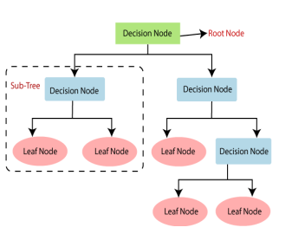
Decision Tree
Non-parametric supervised learning algorithm.
Used for classification and regression tasks.
Recursively partitions data into smaller, homogeneous subsets.
Prediction based on feature values:
Traverse tree from root node to leaf nodes.
Follow branches corresponding to feature values.
Components:
Root node.
Branches.
Leaf nodes.

Slide 8
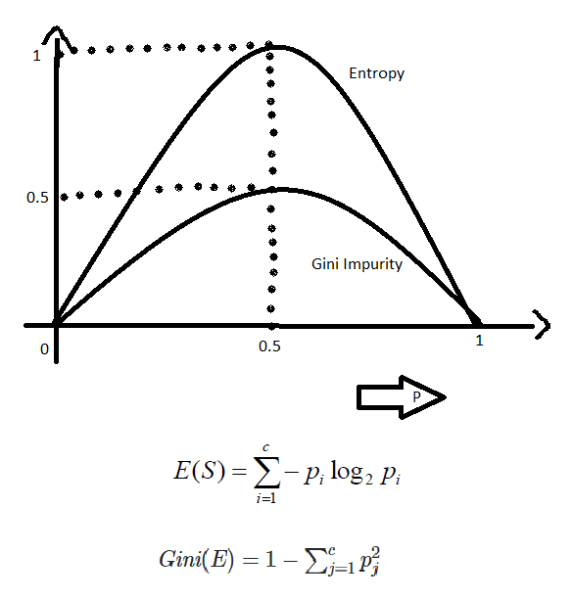
Decision Tree
Description
Recursively partitions data into homogeneous subsets.
Choose the "Best Split": Feature minimizing impurity.
Impurity: Measure of data mixedness in a subset.
Examples of impurity measures: Gini impurity, Entropy.
Interesting Facts
Simplest and most intuitive ML algorithm.
Versatile, suitable for diverse tasks.
Relatively easy to interpret.
Ideal for tasks requiring interpretability

Slide 9
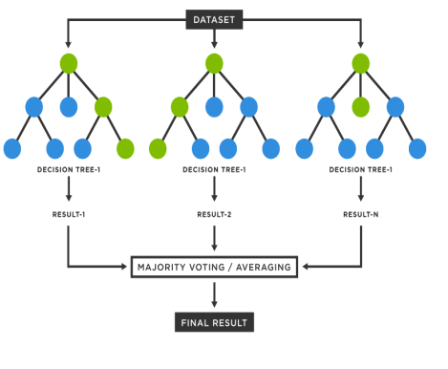
Random Forest
Powerful ML algorithm for classification and regression tasks.
Robust to overfitting, suitable for large datasets.
Commonly used in Natural Language Processing (NLP):
Text classification.
Feature extraction.
Next-word prediction in sequences.
Consists of multiple decision trees.
Versatile and applicable to various tasks.
Ideal for accuracy-focused problems with overfitting concerns.
An ensemble learning algorithm that combines multiple decision trees to make predictions.

Slide 10
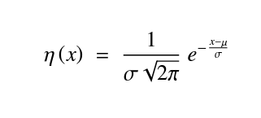
Standardization
To standardize the features, we employed the method proposed by Pal et al. [1] in our study. The standardization formula is defined as follows:
Where:
x is the feature vector
mu is mean and sigma is standard deviation respectively
This approach is adopted to transform the features into a common scale, ensuring that each feature's contribution to the model is consistent and unbiased. By standardizing the features, we mitigate the potential influence of the scale disparities among different features and enhance the overall stability and convergence of our machine learning model.
1. https://doi.org/10.1016/j.procs.2023.01.238

Slide 11

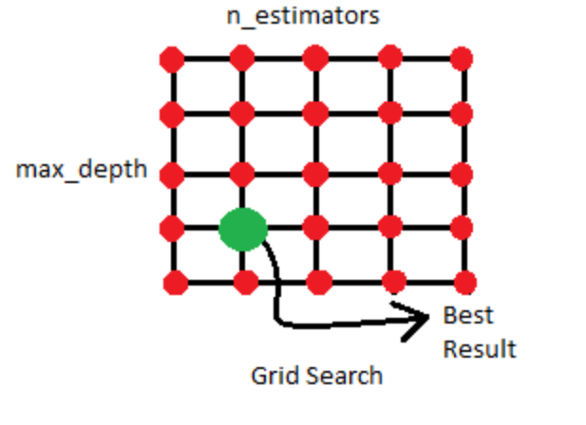
Hyperparameter Search
Grid Search Algorithm
Cross-validation technique for automating hyperparameter tuning.
Evaluates model with various hyperparameter combinations.
Selects the combination producing the best results.
Compatible with any ML model supporting hyperparameter tuning.

Slide 12
Hyperparameter Search
User specifies hyperparameters for evaluation.
Creates a grid of all possible hyperparameter combinations.
Trains a model for each combination.
Evaluates the performance of each model.
Selects the best-performing model.
Saves time and effort in finding optimal parameter values.
Improves machine learning model performance.

Slide 13
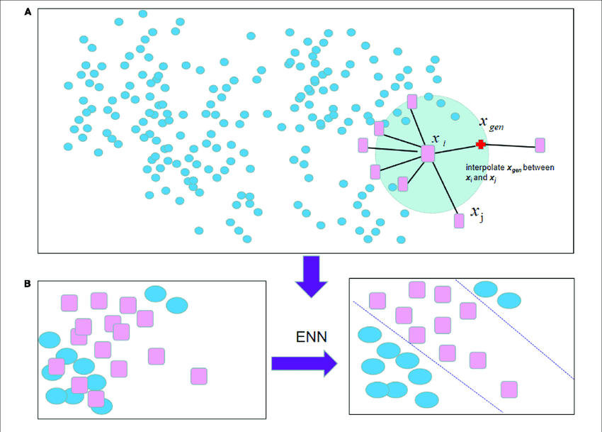
SMOTE + ENN
SMOTE ENN is a hybrid approach to handling imbalanced data that combines the strengths of two other techniques: SMOTE and ENN.
SMOTE is an oversampling technique that generates synthetic minority class samples to balance the dataset.
ENN is an undersampling technique that removes majority class samples that are misclassified by their nearest neighbors.
By combining these two techniques, SMOTE ENN can improve the accuracy of machine learning models on imbalanced datasets.

Slide 14
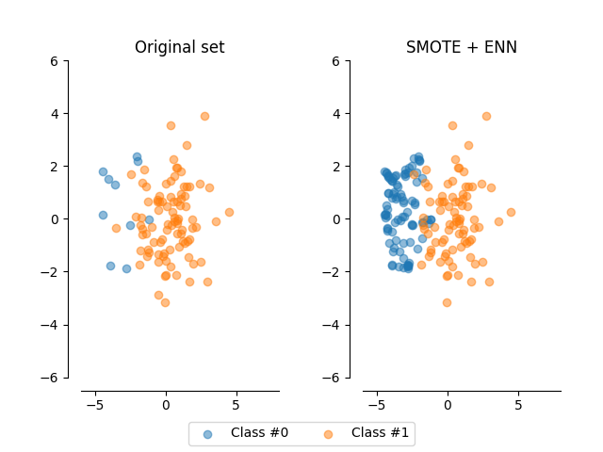
SMOTE + ENN
SMOTE generates synthetic minority class samples.
ENN removes misclassified majority class samples.
Resulting dataset is balanced.
Higher probability of correct classification.
Simple technique, compatible with various ML algorithms.
Caution: May introduce noise and affect model accuracy.
Evaluate performance on validation dataset before production.

Slide 15
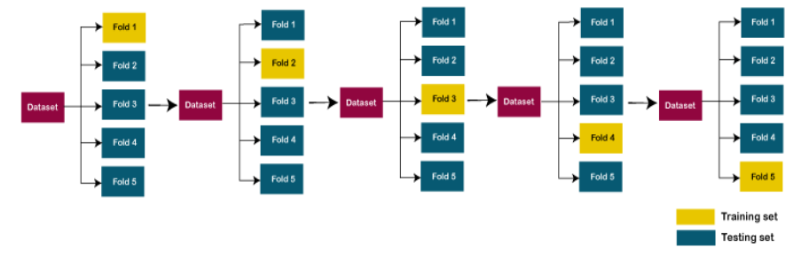
Cross Validation
Overfitting: Model learns training data too well, struggles to generalize.
Cross-validation: Technique to prevent overfitting.
Split training data into multiple folds.
Train model on different fold each time.
Evaluates on unseen data to ensure generalization.
Common methods:
K-fold cross-validation
Leave-one-out cross-validation

Slide 16
Cross Validation
Hyperparameters: Control a model's behavior (e.g., hidden layers, learning rate).
Importance: Crucial for optimal model performance.
Challenge: Difficult to select without cross-validation.
Cross-validation: Evaluates different hyperparameter settings.
Benefits:
Avoids overfitting.
Identifies best hyperparameters.
Powerful technique for accurate and reliable ML models.
Essential for Data Scientists to build high-performing models.

Slide 17

EXPLORATORY DATA ANALYSIS

Slide 18
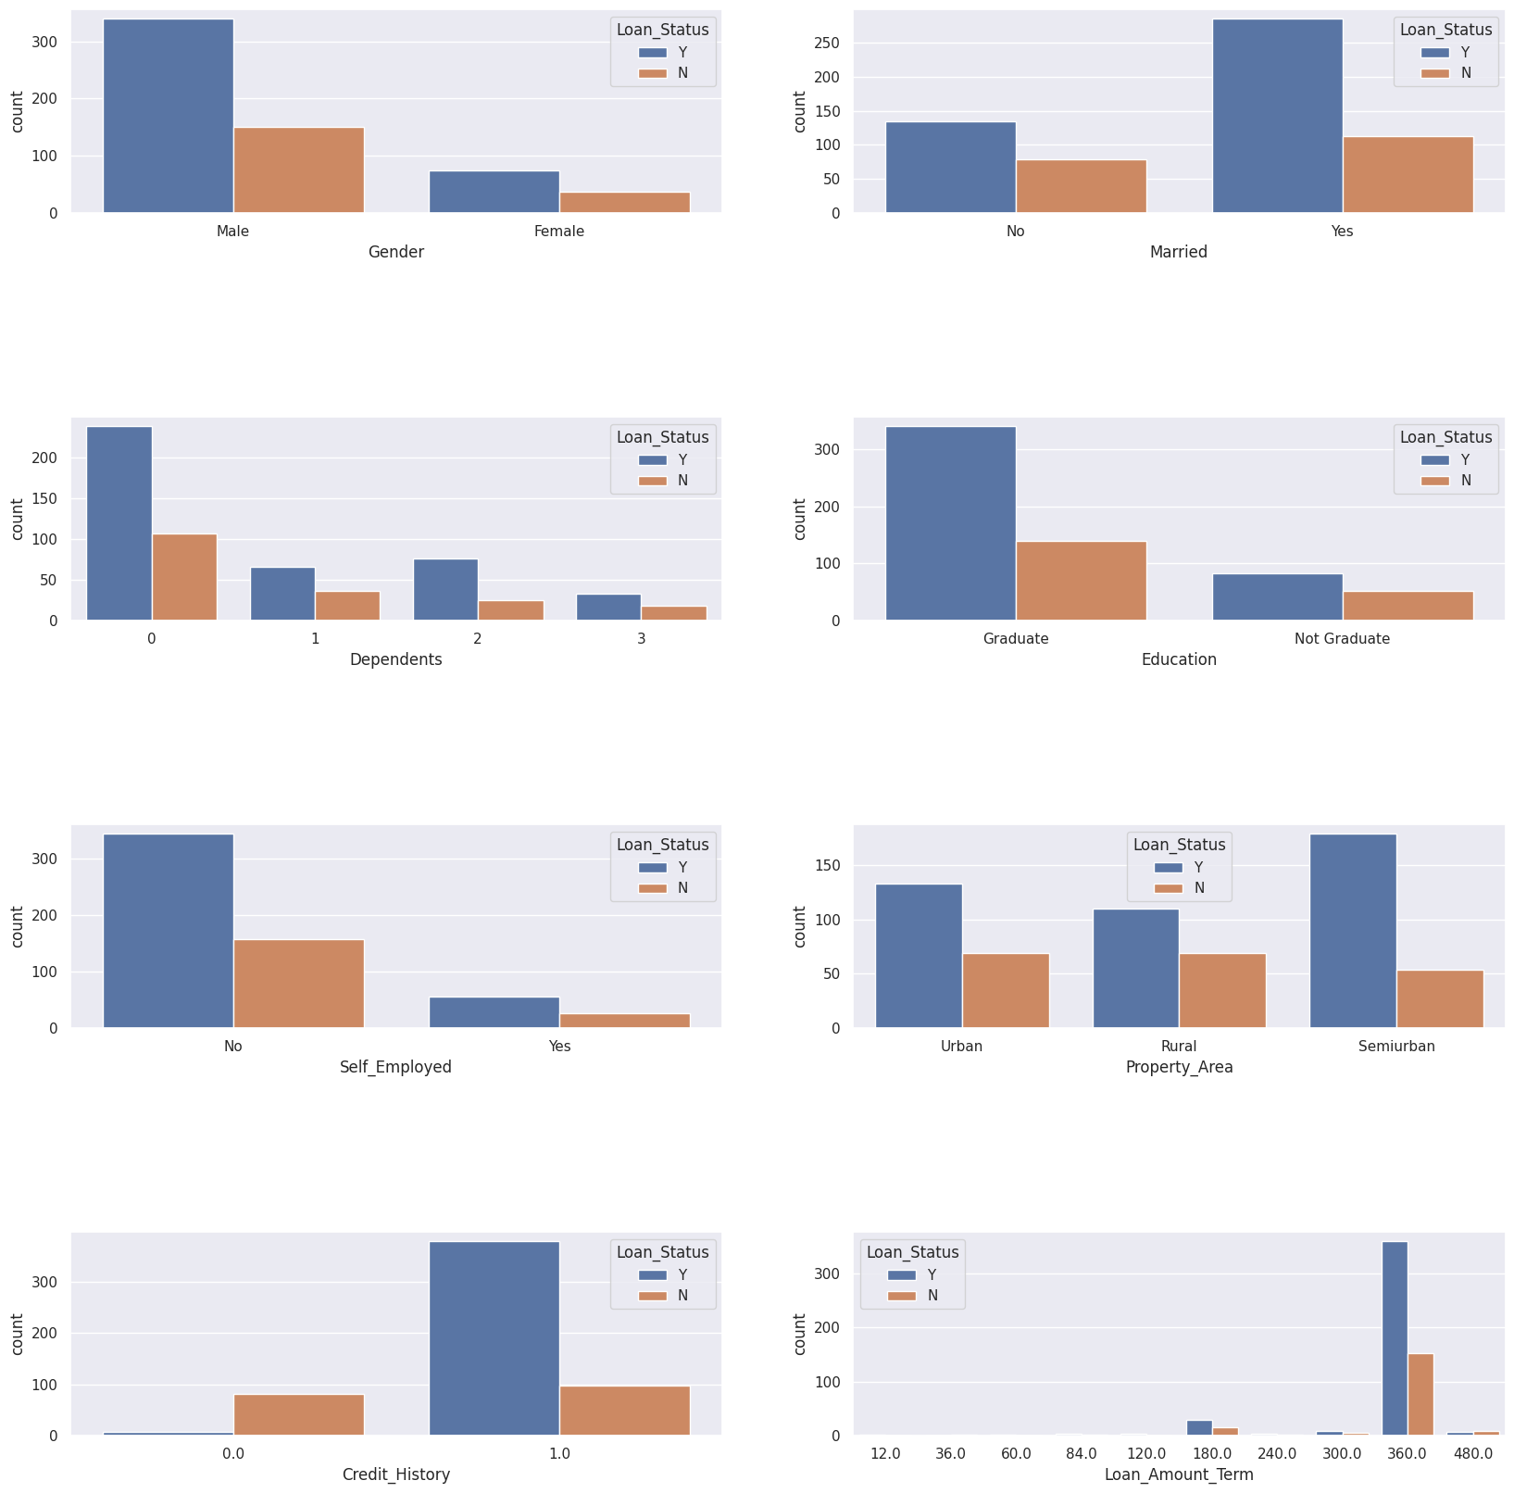
DATA VISUALIZATION

Slide 19
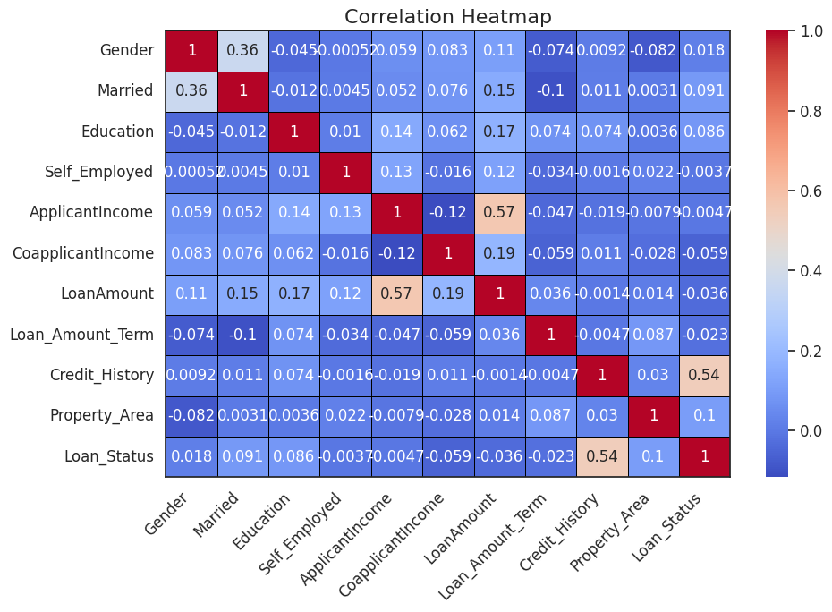
CORRELATION PLOT

Slide 20
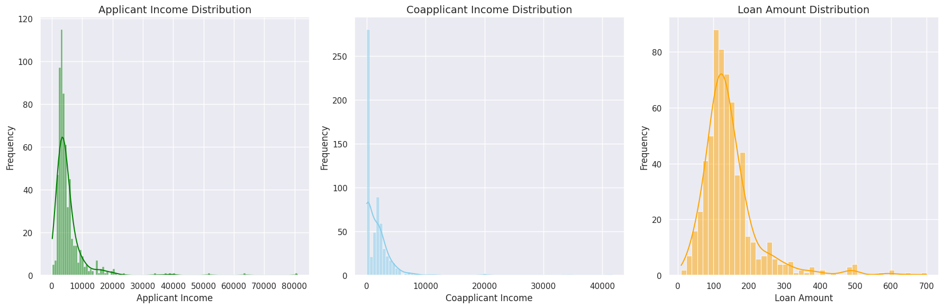
DISTRIBUTION AND DENSITY CURVE

Slide 21

Experimental Results
Accuracy Scores without using Hyperparameter Search (Random Selection)
Models | Accuracy (Percent)
SVM (Linear Kernal) | 82.29
Logistic Regression | 80.09
SVM (Radial Basis Function) | 68.75
Decision Tree | 75
Random Forest | 72.91

Slide 22
Experimental Results
Grid Search Result
Parameters | Values
Cost Parameter | 100
Gamma | 0.1
Kernel | Linear

Slide 23
Class Imbalance Removal
SMOTE + ENN
Class 0 Data points before SMOTE+ENN | 148
Class 1 Data points before SMOTE+ENN | 332
Class 0 Data points after SMOTE+ENN | 179
Class 1 Data points after SMOTE+ENN | 180

Slide 24
Experimental Results
Accuracy Analysis of Linear SVM
Condition | Accuracy
Accuracy Before Using Grid Search | 80.29
Accuracy After Using Grid Search | 82.29
Accuracy After Using SMOTE + ENN and Grid Search | 84.29

Slide 25
Experimental Results
Confusion Matrix
Confusion Matrix | Predicted YES | Predicted NO
Actual YES | 27 | 0
Actual NO | 11 | 32

Slide 26
Experimental Results
Classification Report
Class | Precision | Recall | F1 Score
0 | 0.71 | 1..00 | 0.83
1 | 1.00 | 0.74 | 0.85

Slide 27
Experimental Results
Cross Validation Analysis
nth Fold | Accuracy
Fold 1 | 90
Fold 2 | 91.42
Fold 3 | 80
Fold 4 | 77.14
Fold 5 | 85.71
Mean Accuracy (±/- std dev) | 84.85 (+/5.53)

Slide 28
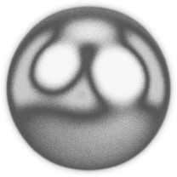
Conclusion
Optimal Model : Linear SVM
Linear SVM achieved the best accuracy among the models tested in the loan prediction project.
Hyperparameter Tuning with Grid Search
Grid Search significantly improved model performance by fine-tuning hyperparameters.
Addressing Imbalance with SMOTE ENN
The technique generated synthetic minority class samples and removed misclassified majority class samples.
Cross-Validation Accuracy (84.85%)
Achieving a 94% accuracy across different folds demonstrates the reliability of our predictions.

Slide 29
Conclusion
Application in Real-World Scenarios
The developed loan prediction model can be deployed to streamline loan approval processes.
It reduces the risk of erroneous decisions and ensures efficient use of resource
Future Scope
Investigate interpretability of the model for better insights into loan approval decisions.
Extend the model to handle more complex features and explore other potential data sources.

Slide 30

Thank you!

